Slide 1




MCIT 596 MODULE 11.5
Bipartite Matching – Correctness and Further Observations
Sampath Kannan

Slide 2




RECAP : BIPARTITE MATCHING VIA FLOWS
1
1
1
1
1
1
1
1
s
t
$$V_{1}$$
$$V_{2}$$
Middle layer edges have capacity ∞

Slide 3
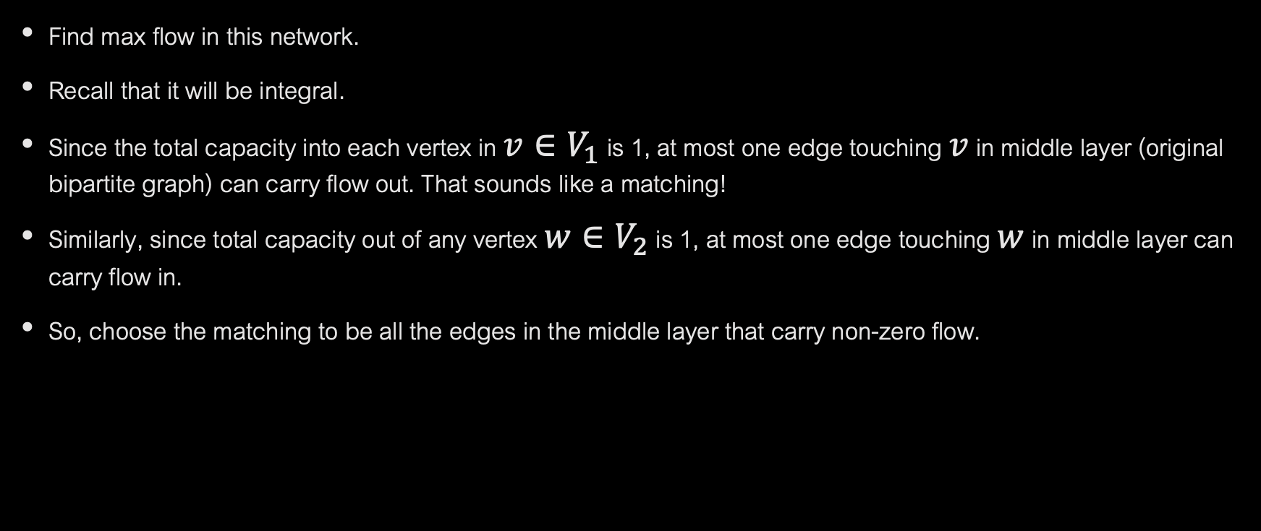
BIPARTITE MATCHING VIA FLOWS
Find max flow in this network.
Recall that it will be integral.
Since the total capacity into each vertex in ${v∈V}_{1}$ is 1, at most one edge touching $v$ in middle layer (original bipartite graph) can carry flow out. That sounds like a matching!
Similarly, since total capacity out of any vertex ${w∈V}_{2}$ is 1, at most one edge touching $w$ in middle layer can carry flow in.
So, choose the matching to be all the edges in the middle layer that carry non-zero flow.

Slide 4

WHY DOES IT WORK?
If bipartite graph has a matching of size $k,$ then flow network has flow of value $k.$
Conversely, if flow network has flow of value 𝓁, then (as we saw in the last slide) there is a matching of size 𝓁.
So, maximum matching corresponds to max flow value…
And this is what the max flow algorithm finds!

Slide 5

HALL’S THEOREM
Max-flow min-cut theorem allows us to make an important observation about matchings in bipartite graphs.
Say a matching is perfect if it matches all vertices.
For a set of vertices $S$, define $Γ\left(S\right)=\{v: ∃u∈S:(u,v)∈E\}$
Hall’s theorem: A bipartite graph $G=(V_{1}∪V_{2},E)$ has a perfect matching if and only if:
$\left|V_{1}\right|=\left|V_{2}\right|$
$∀S⊆V_{1},|Γ(S)|≥|S|$

Slide 6



PROOF OF HALL’S THEOREM
For a perfect matching to exist, the conditions of Hall’s Theorem are clearly necessary. If the two sides have different numbers of vertices, no perfect matching can exist.
If $\left|Γ\left(S\right)\right|<\left|S\right|,$ vertices in $S$ cannot all be matched.
$$Γ(S)$$
$$S$$

Slide 7

OTHER DIRECTION MORE CHALLENGING
Suppose for all sets $S⊆V_{1}, \left|Γ\left(S\right)\right|≥\left|S\right|$holds true.
Then why does there always exist a perfect matching?
We will show by contradiction, that the min-cut in the flow network for $G$ must have capacity $n=\left|V_{1}\right|=|V_{2}|$.
Then by max-flow-min-cut theorem, the max flow will also be of size $n$.
Finally, this implies that $n$ edges in middle layer are carrying flow, which means that the matching we get is of size $n$.

Slide 8

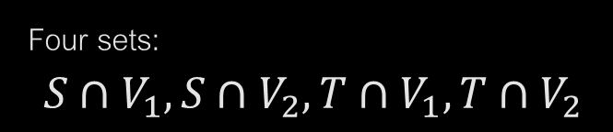







PROOF OF HALL’S THEOREM
Suppose min-cut is of size less than $n$. Let’s picture this situation...
$$S$$
Four sets:
$$S∩V_{1},S∩V_{2},T∩V_{1},T∩V_{2}$$
1
1
1
1
1
1
1
1
Let’s understand cut capacity in terms of these 4 sets.
$$s$$
$$t$$
$$T$$
$$V_{1}$$
$$V_{2}$$

Slide 9
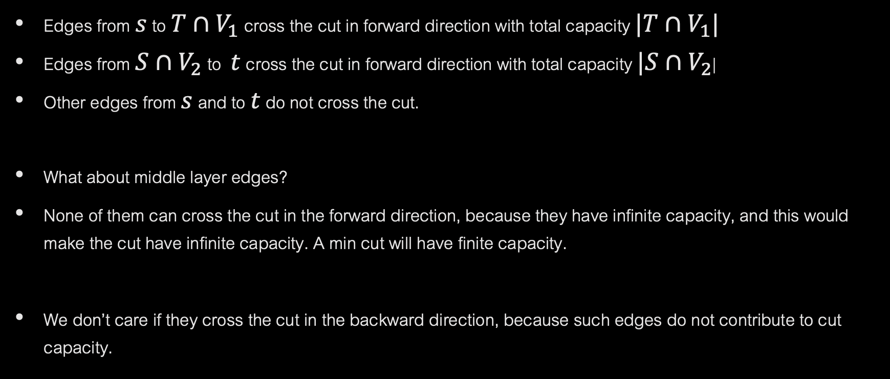
PROOF OF HALL’S THEOREM
Edges from $s$ to $T∩V_{1}$ cross the cut in forward direction with total capacity $|T∩V_{1}|$
Edges from $S∩V_{2}$ to $t$ cross the cut in forward direction with total capacity $|S∩V_{2}$|
Other edges from $s$ and to $t$ do not cross the cut.
What about middle layer edges?
None of them can cross the cut in the forward direction, because they have infinite capacity, and this would make the cut have infinite capacity. A min cut will have finite capacity.
We don’t care if they cross the cut in the backward direction, because such edges do not contribute to cut capacity.

Slide 10
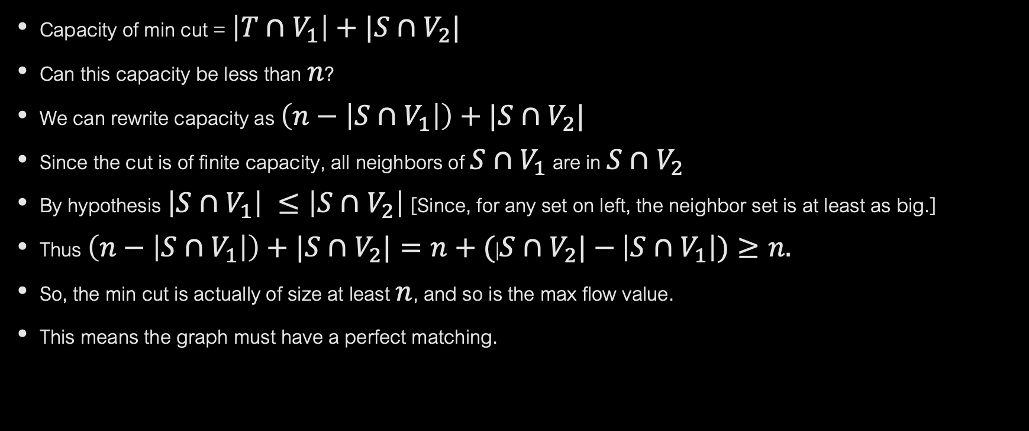
CAPACITY OF MIN-CUT
Capacity of min cut = $\left|T∩V_{1}\right|+|S∩V_{2}|$
Can this capacity be less than $n$?
We can rewrite capacity as $\left(n−\left|S∩V_{1}\right|\right)+|S∩V_{2}|$
Since the cut is of finite capacity, all neighbors of $S∩V_{1}$ are in $S∩V_{2}$
By hypothesis $\left|S∩V_{1}\right| ≤\left|S∩V_{2}\right|$[Since, for any set on left, the neighbor set is at least as big.]
Thus $\left(n−\left|S∩V_{1}\right|\right)+|S∩V_{2}|=n+($|$S∩V_{2}|−$ $\left|S∩V_{1}\right|)≥n.$
So, the min cut is actually of size at least $n$, and so is the max flow value.
This means the graph must have a perfect matching.

